Slide 1

Web Scraping Project :
How much salary can you expect for your tech skill?
Sean Hong

Slide 2

INTRODUCTION
What are your special skills?
JAVA, SQL !
Python, R !
C++ !
Blockchain !
Android, iOS !

Slide 3
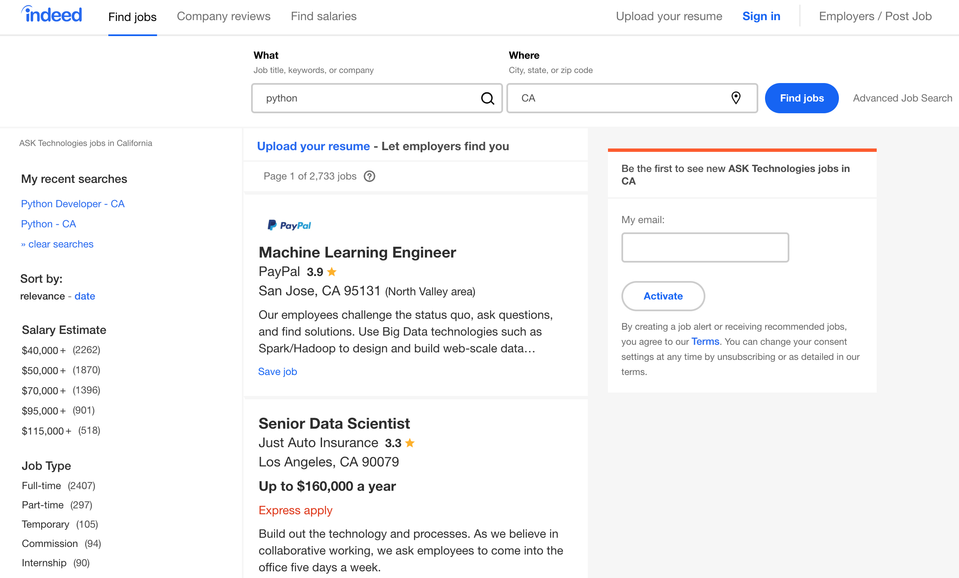
WEB CRAWLING
https://www.indeed.com
keyword
location
salary

Slide 4
HOW TO
Web Crawler : Scrapy
Cleansing & Visualization : Pandas, NumPy, Plotly
Search skill keywords from web (stackoverflow, google) & select 25 popular keywords.
java, python, r, sql, hadoop, spark, c#, c++, javascript, angular, node.js, linux, tensorflow, kubernetes, docker, android, ios, aws, azure, kafka, vb, php, scala, go…
Develop scrapy application to Input each keyword into indeed.com search engine.
URL : https://www.indeed.com/jobs?q={keyword}&l={location}&limit=50&start={50 * (page -1)}
Iterate keywords & collect job results of URL request call.
Skip job results that have not salary information.
Save to CSV file.
There is 1,000 count limitation of search result.
Add more condition to get more sample
Location : CA, NY, FL, TX…
Level : entry, mid, senior

Slide 5
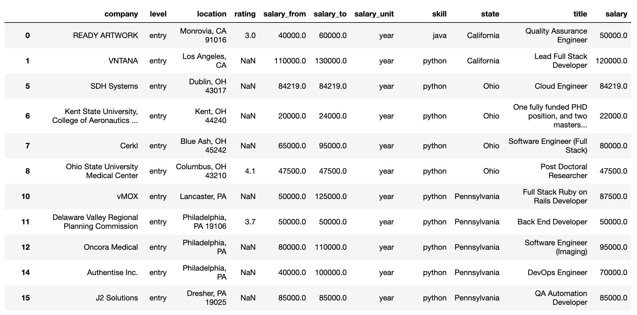
DATA SET

Slide 6
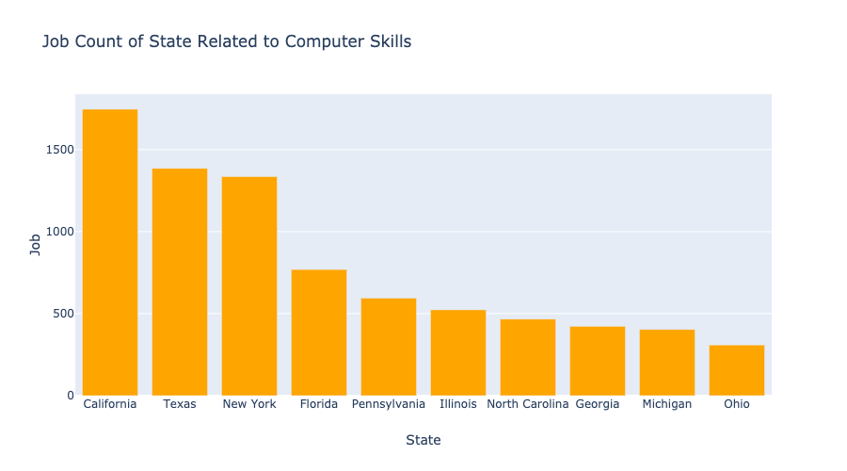
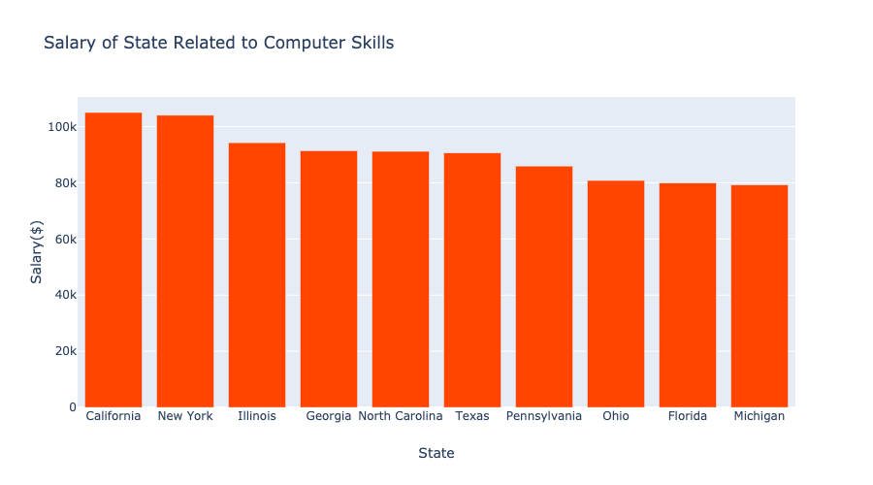
ANALYSIS #1

Slide 7
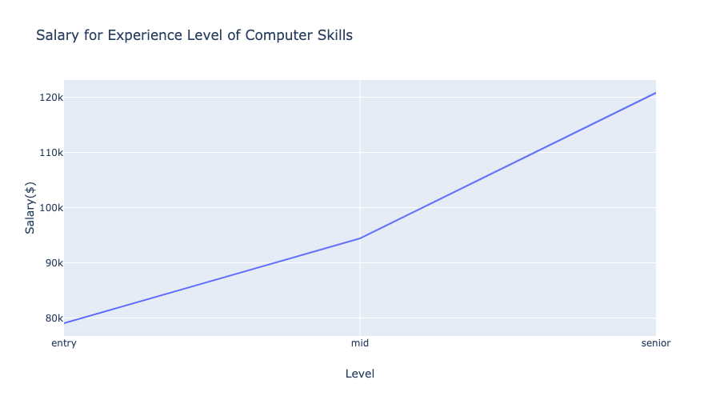
ANALYSIS #2

Slide 8
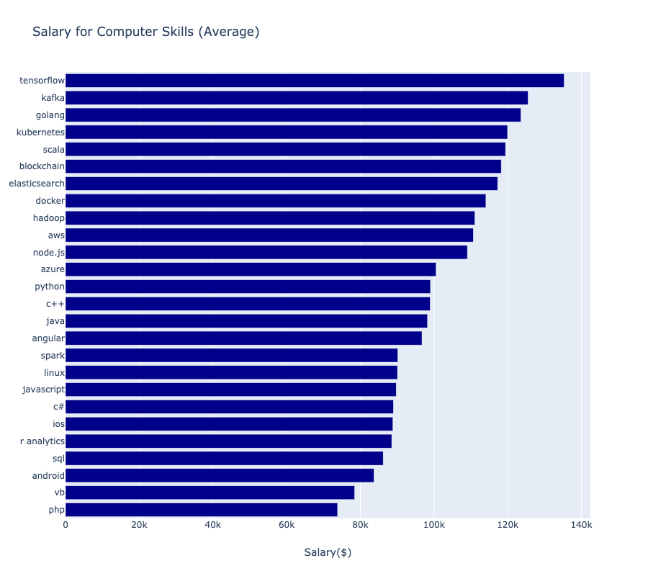
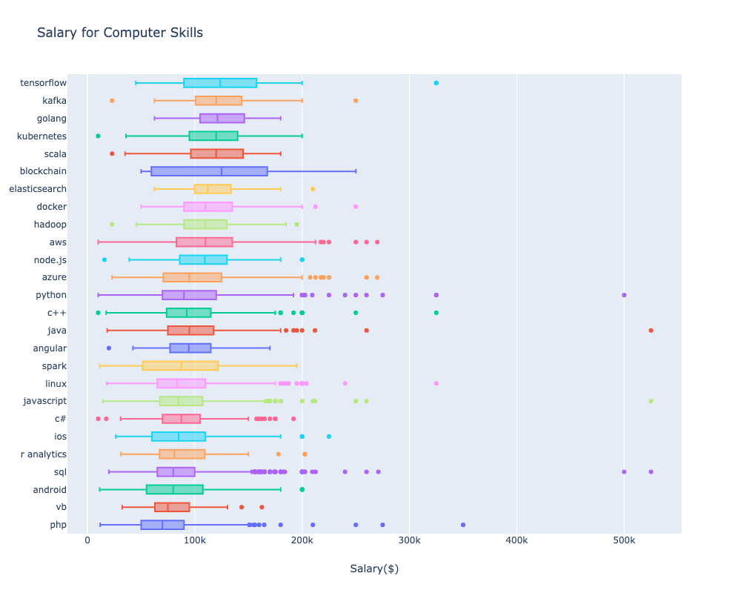
ANALYSIS #3

Slide 9
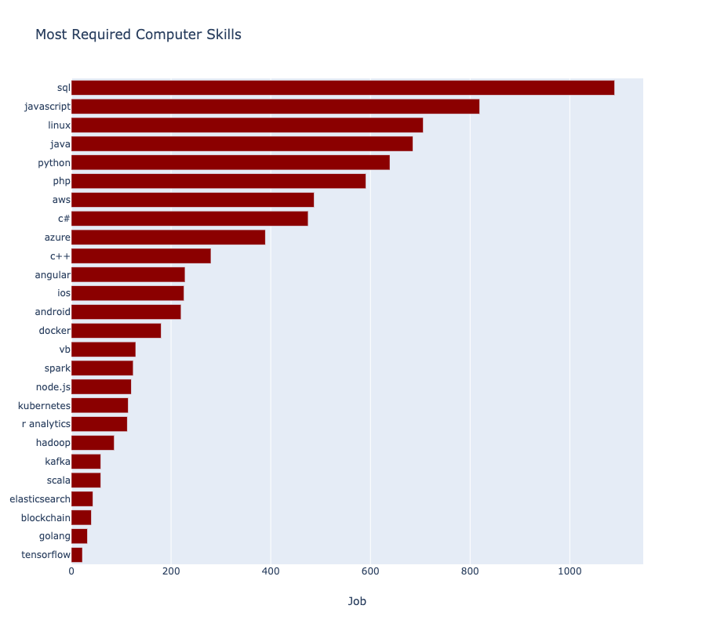
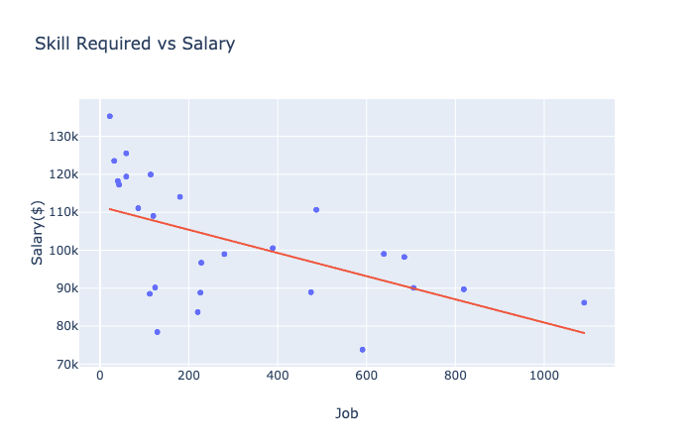
ANALYSIS #4

Slide 10
FUTURE WORK
If skills are more than one, is it relate to get more salary?
Try to search mixed keyword.
Ex) java + sql, python + r…
Amount of sample is not enough because many company don’t show salary directly.
Find how to get more sample.
Study English!

